Slide 1

Springboard – DCS
Capstone Project 2
Predicting Fetal Cardiac Health Outcomes
Using Cardiotocogram Data
By Michael Bobal
January 2023

Slide 2
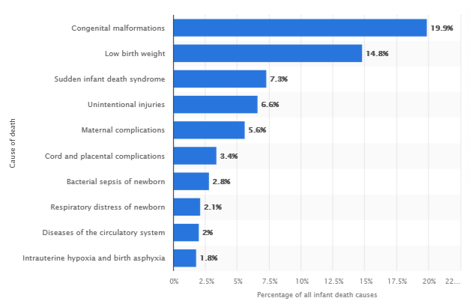
Introduction
- Congenital malformations like heart defects (CHD), are responsible for nearly 20% of infant deaths.
- CHDs affect nearly 1% of children born alive, totaling nearly 40,000 cases per year.
- Of those 1% of children born with CHDs, about 25% are critical.
https://www.statista.com/statistics/946675/leading-causes-of-infant-death-in-the-us/

Slide 3
Introduction
Cardiotogography (CTG) is a non-invasive, in-utero fetal heart-health test that obstetricians use to detect the presence of CHD.
Interpreting the results usually requires a highly trained physician, who carefully considers the multiple measurements of the CTG in order to classify fetuses as either normal, suspect, or pathological.
Accurate diagnosis is a critical step for our stakeholders:
Affected children, parents, obstetricians, surgeons, and hospitals.

Slide 4
Goal:
Develop a machine learning model that uses CTG data to quickly and accurately predict the cardiac status of a fetus.

Slide 5
Approach: Data Acquisition and Wrangling
Data is from University of California Irvine Machine Learning Repository
Ayres de Campos et al. (2000) SisPorto 2.0 A Program for Automated Analysis of Cardiotocograms. J Matern Fetal Med 5:311-318
Our project only used the columns corresponding to features suggested in the data file, totaling 21 independent variables for 2126 CTG instances

Slide 6
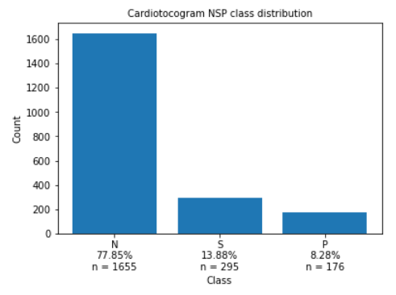
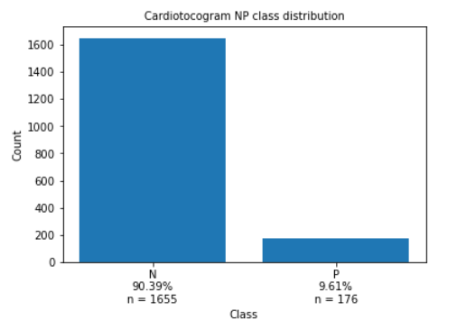
Our data:
- Each CTG instance classified as Normal, Suspect, or Pathological by a medical professional
- Includes “Suspect” as a class designation, which we eliminated from modeling
- Highly imbalanced

Slide 7
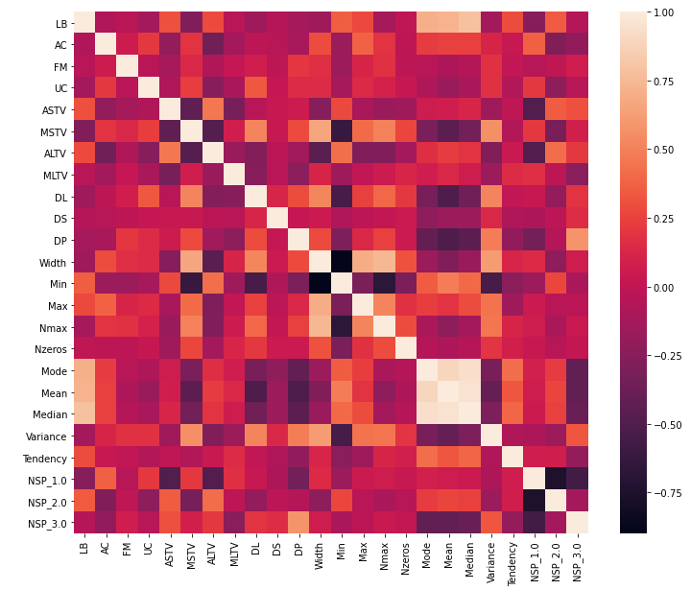
Feature correlations:
- Highly correlated features with features:
>Mean, Median, Mode
>Min, Width
- Highly correlated features with target:
>ASTV and ALTV with Normal class
>Mean/Median/Mode with Pathological class

Slide 8
Baseline Modeling
Goal of modeling: High sensitivity (good detection abilities)
Performance metric of choice: Recall (True Positives / All Positives)
Reason: Medical classification problems tend to value reducing false negatives

Slide 9
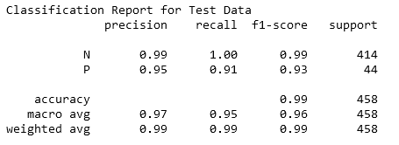
Good is Bad
- Initial algorithm chosen for model-building was Logistic Regression
- Model performance without any tuning achieved improbable results
- >90% on all standard performance metrics
- Recall score = 0.91
- Data leakage is a likely culprit

Slide 10
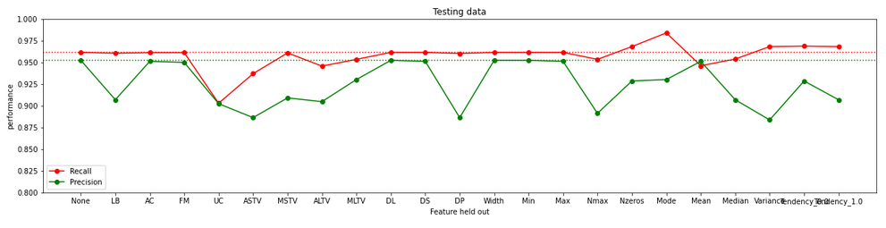
Investigating single features for leakage
- Using a feature hold-out function, the model was repeatedly run.
- Precision and Recall scores for each iteration were charted.
- No obvious signs that one feature is the source of the data leakage issue.

Slide 11
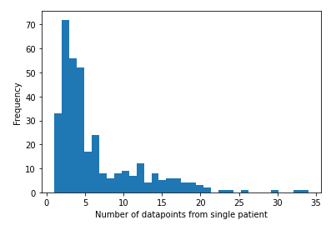
Leakage Located
- Further review of the data showed that most subjects had multiple CTG data entries
- Data from subjects was ending up in both the training set and the testing set for modeling
- The model was over-fit to the particular patients involved

Slide 12
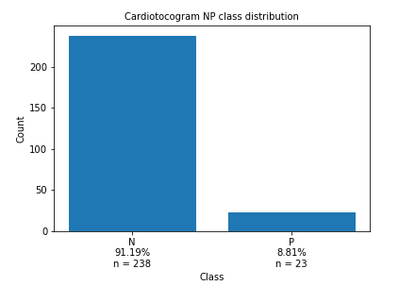
Redo EDA
- Using grouping and aggregation, we condensed the data from 2126 to 352 data-points
- Class imbalance remained ~10:1

Slide 13
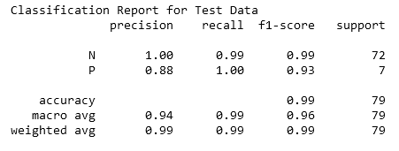
Redo Baseline Modeling
- Repeating our steps from before, we used Logistic Regression
- Again, the results are astoundingly good. Too good.
- Recall = 1.00
- The leakage issue is not solved

Slide 14
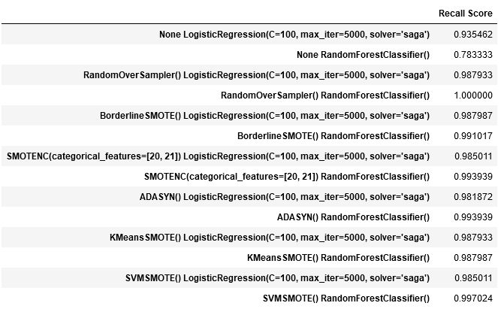
The problem of leakage is consistent:
Comparing cross-validation performance when using over-sampling techniques on the data show similarly excellent results.

Slide 15
Findings
Unfortunately, upon further inspection of the raw data, we discovered:
1. The CTG entries corresponding to each patient overlapped in time. Some of the data-points encompassed entirely the rest of that patient's data.
2. Some unseen data leakage is continuing to occur, even after the fixes we established.

Slide 16
Findings
Unfortunately, upon further inspection of the raw data, we discovered:
1. The CTG entries corresponding to each patient overlapped in time. Some of the data-points encompassed entirely the rest of that patient's data.
2. Some unseen data leakage is continuing to occur, even after the fixes we established.

Slide 17
Conclusions
Based on our findings, we strongly recommend making the following concrete data collection improvements:
1. Supply the data team with CTG data from more subjects. Increasing the testing is a more reliable approach than artificially oversampling limited data.
2. Include in future data collection only a single data entry per patient. This was a cause of major information leakage, led to over-fitting during modeling, and is a bad practice for the type of problem that we are trying to solve.
3. Ensure a standard amount of time that each CTG may collect data for.

Slide 18
Thank you to AJ, my mentor,
for helping to steer me in the proper direction throughout this project.

